Slide 1

Welcome to my Presentation
Platform for gamers and gaming community.

Slide 2
Introduction
My name is IMRAN bin Yousuf I’m a doing a gaming base project
I don’t have any team partner it’s a single project.
Motivation
I'm doing a gaming base project, my motivation of doing this project to help Bangladeshi gaming community.
Aslo my dream is create a big gaming community in my country.

Slide 3
Technology Used
HTML5,CSS, BOOTSTRAP 4
Jquery
MySQL
Visual Studio Code, Sublime Text
Xampp

Slide 4
Methodology- USE Case
Find your favorite game
admin login
user login
Admin upload game
Search game
Fixed price
payment
Fixed Category
Contact other gamers
logout

Slide 5
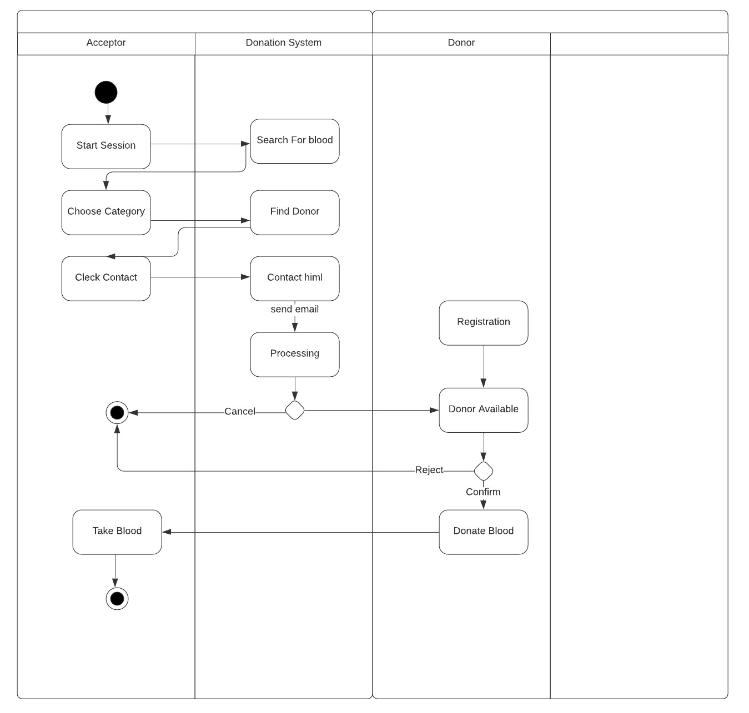
Methodology - Activity Diagram
gamer
Buy gamer
admin
Search game
find game
Check payment
Check available
admin
Game available
play Game
buy Game

Slide 6
Limitation:
For Bangladesh I don’t have add PayPal
We don’t add all game because of govt. restriction.

Slide 7
Future plan:
We add messaging system for communicate other gamers.
We divide premium and non premium membership.
We add gaming payment system.

Slide 8
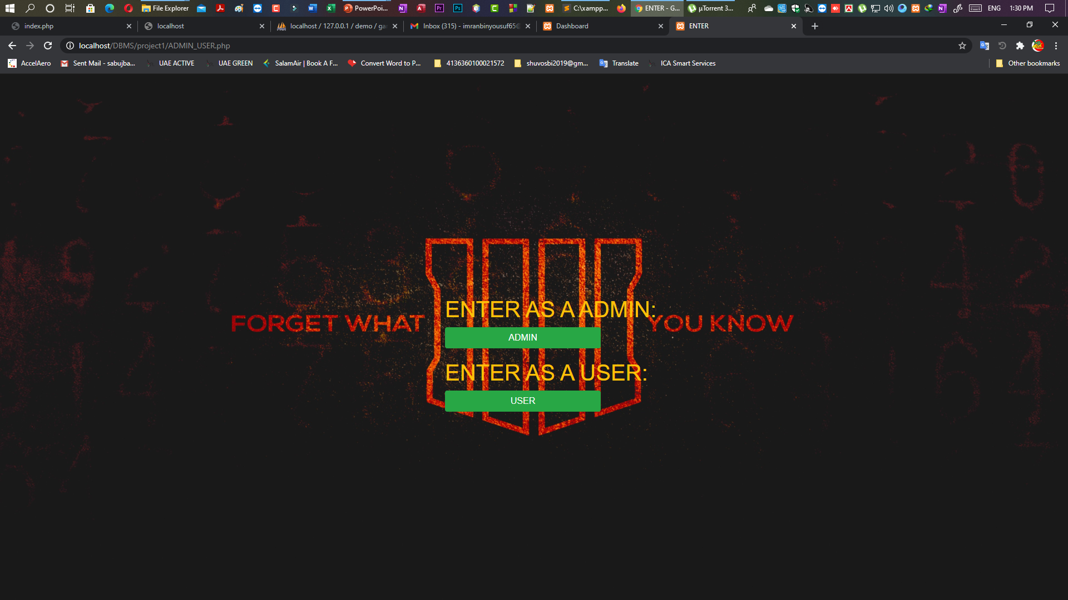
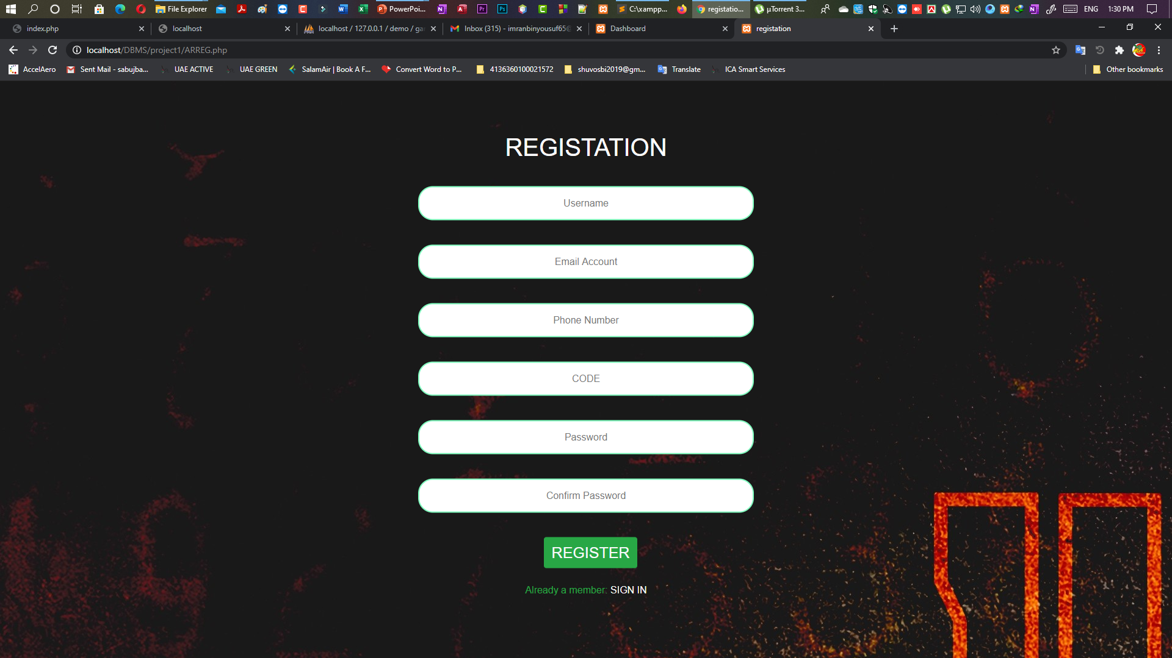
ScreenShots

Slide 9
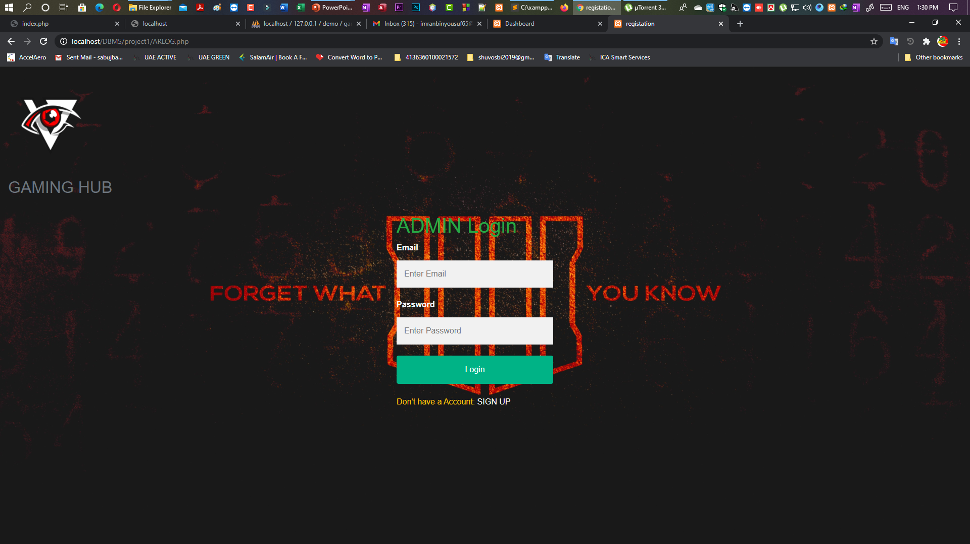
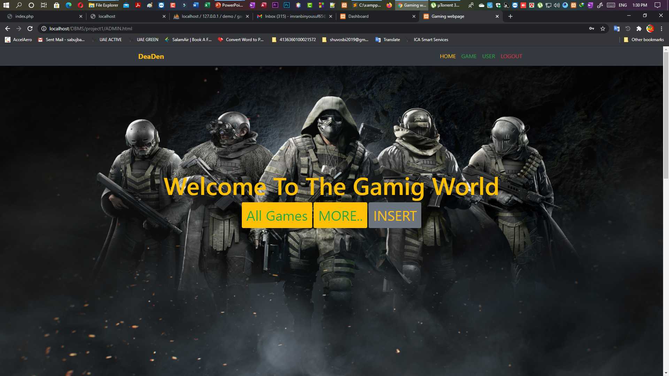
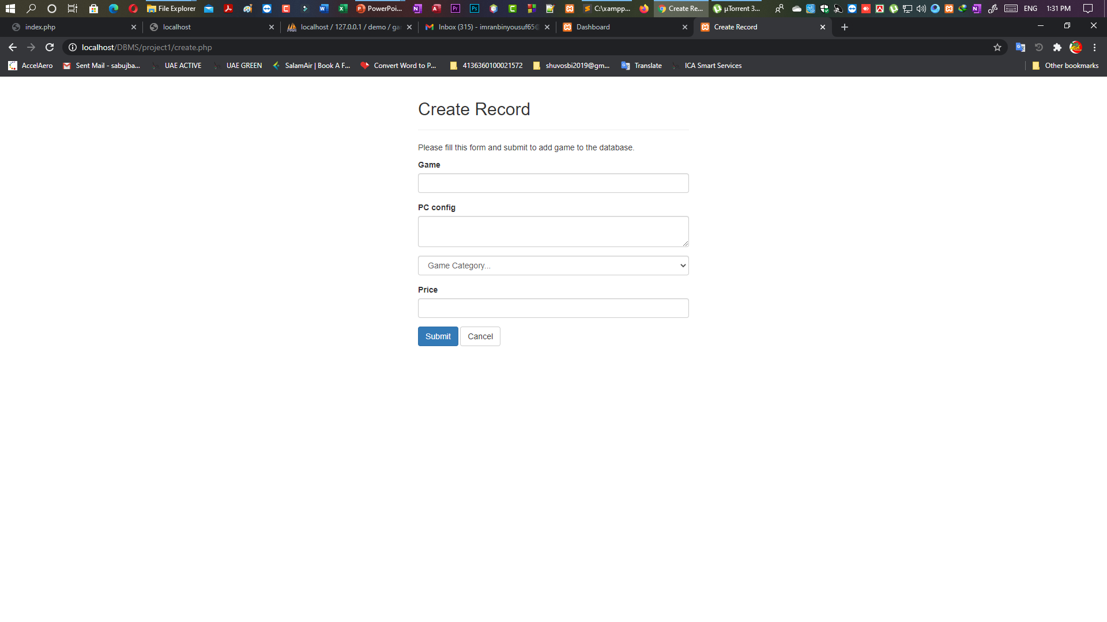
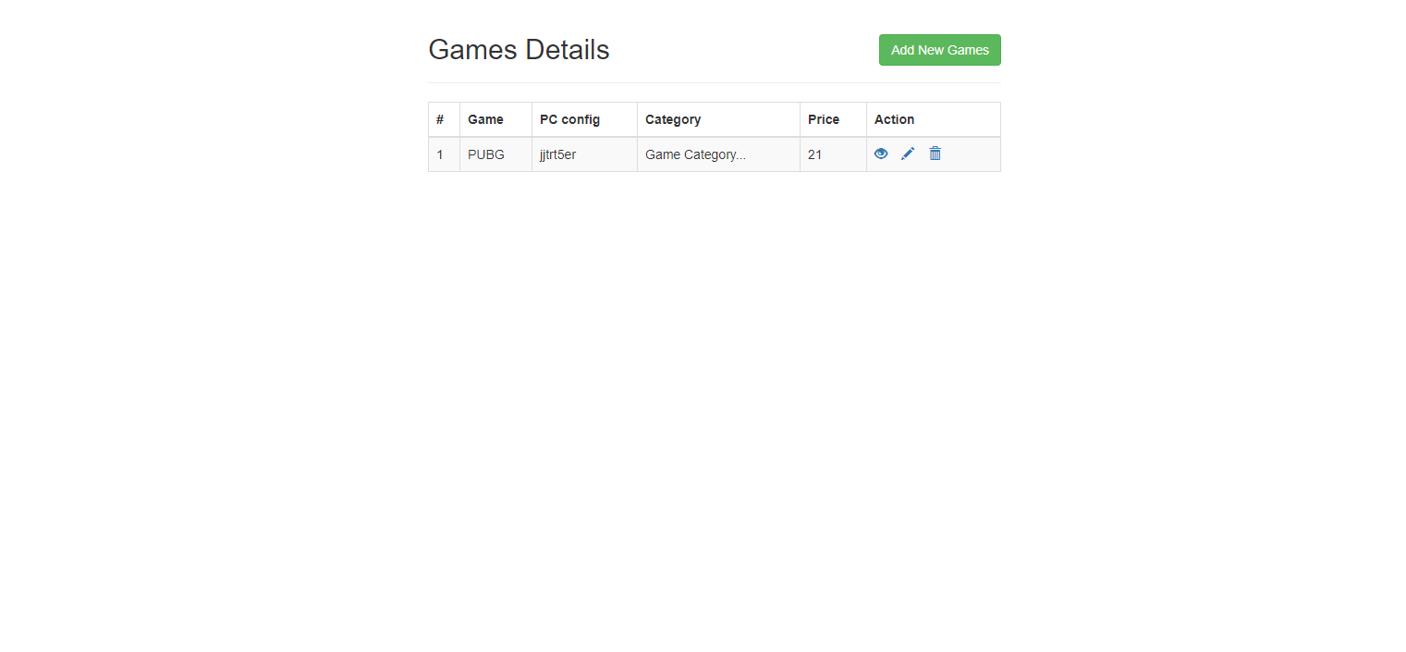

Slide 10
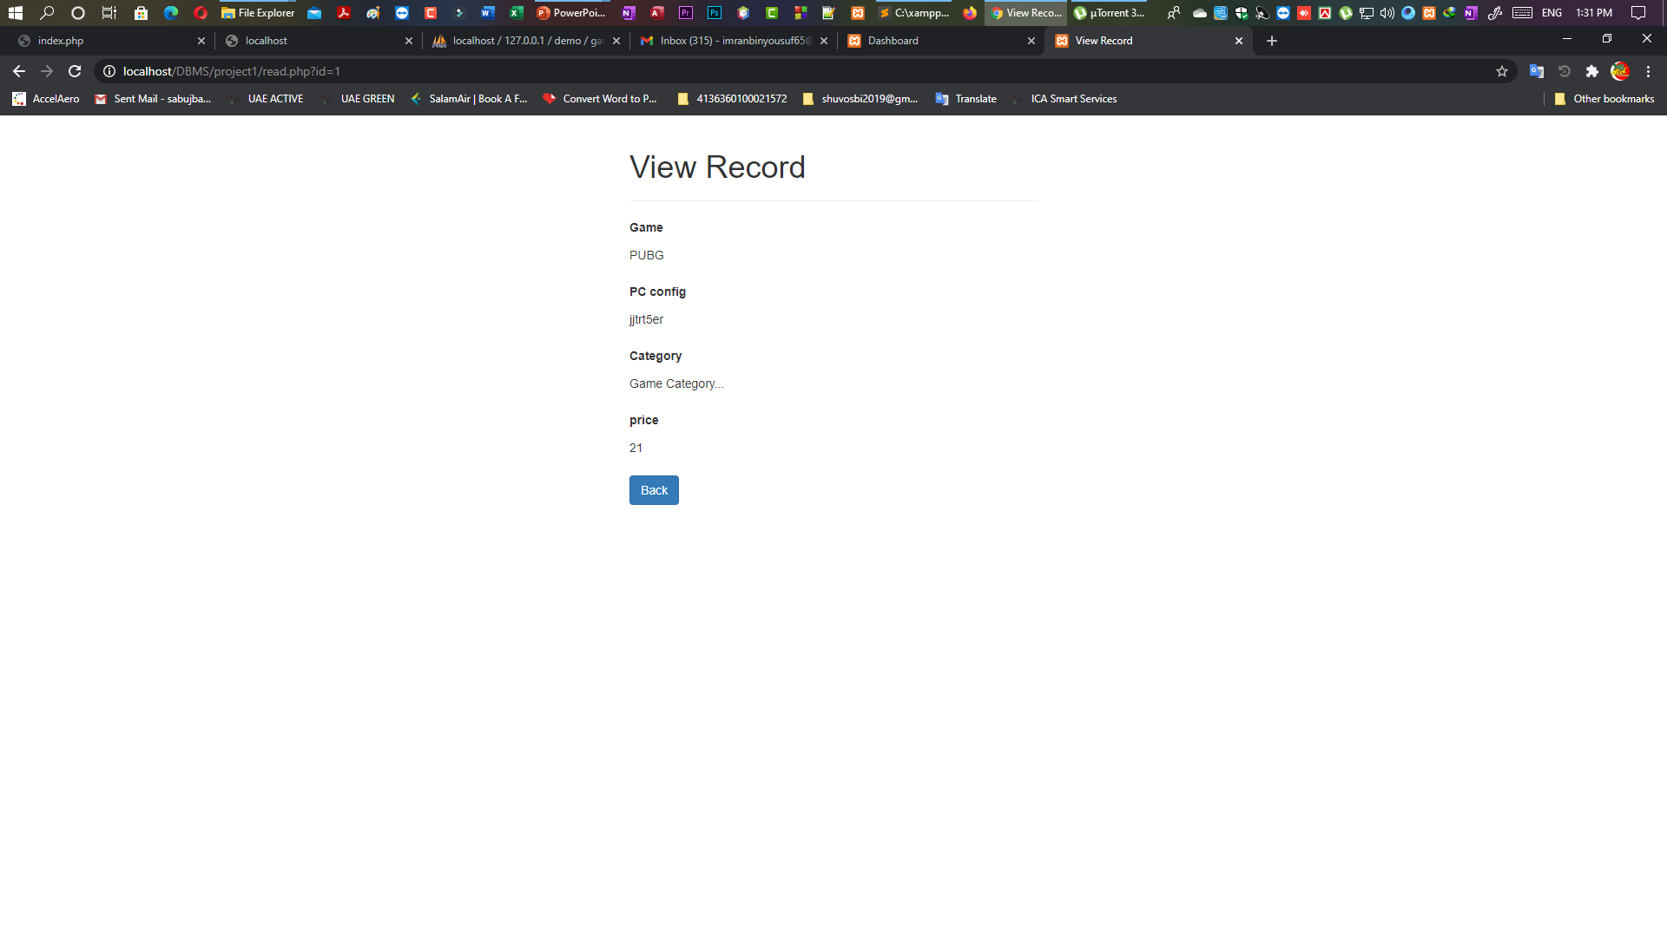
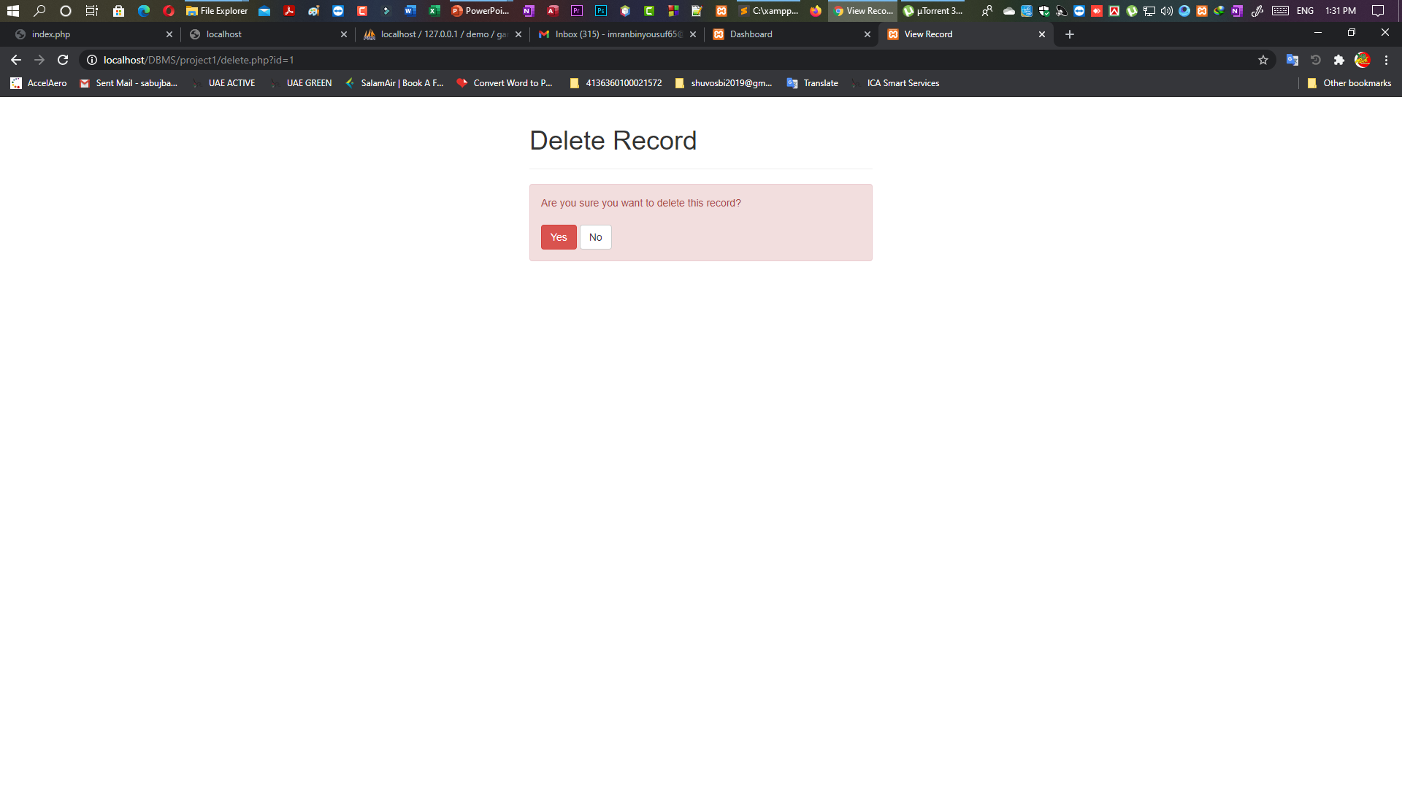



Slide 11
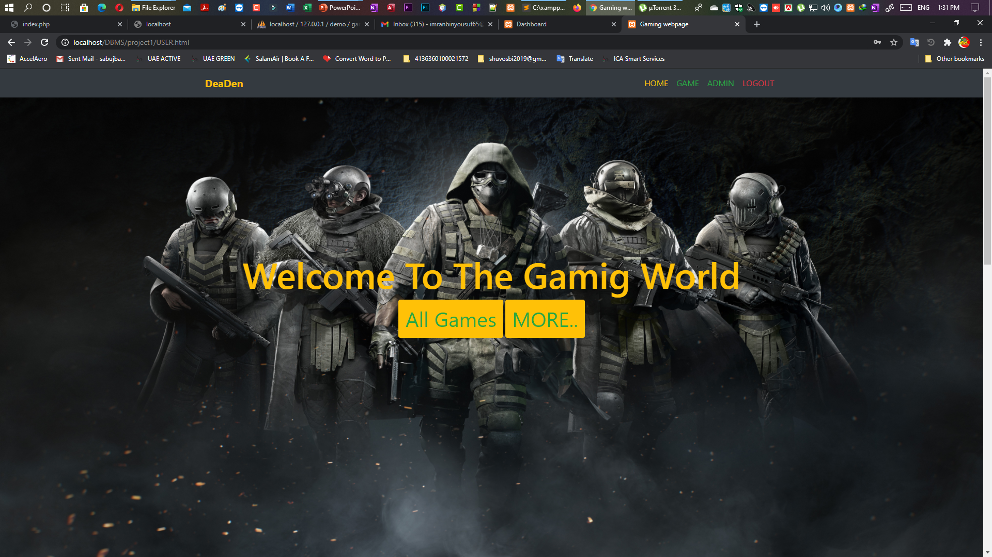
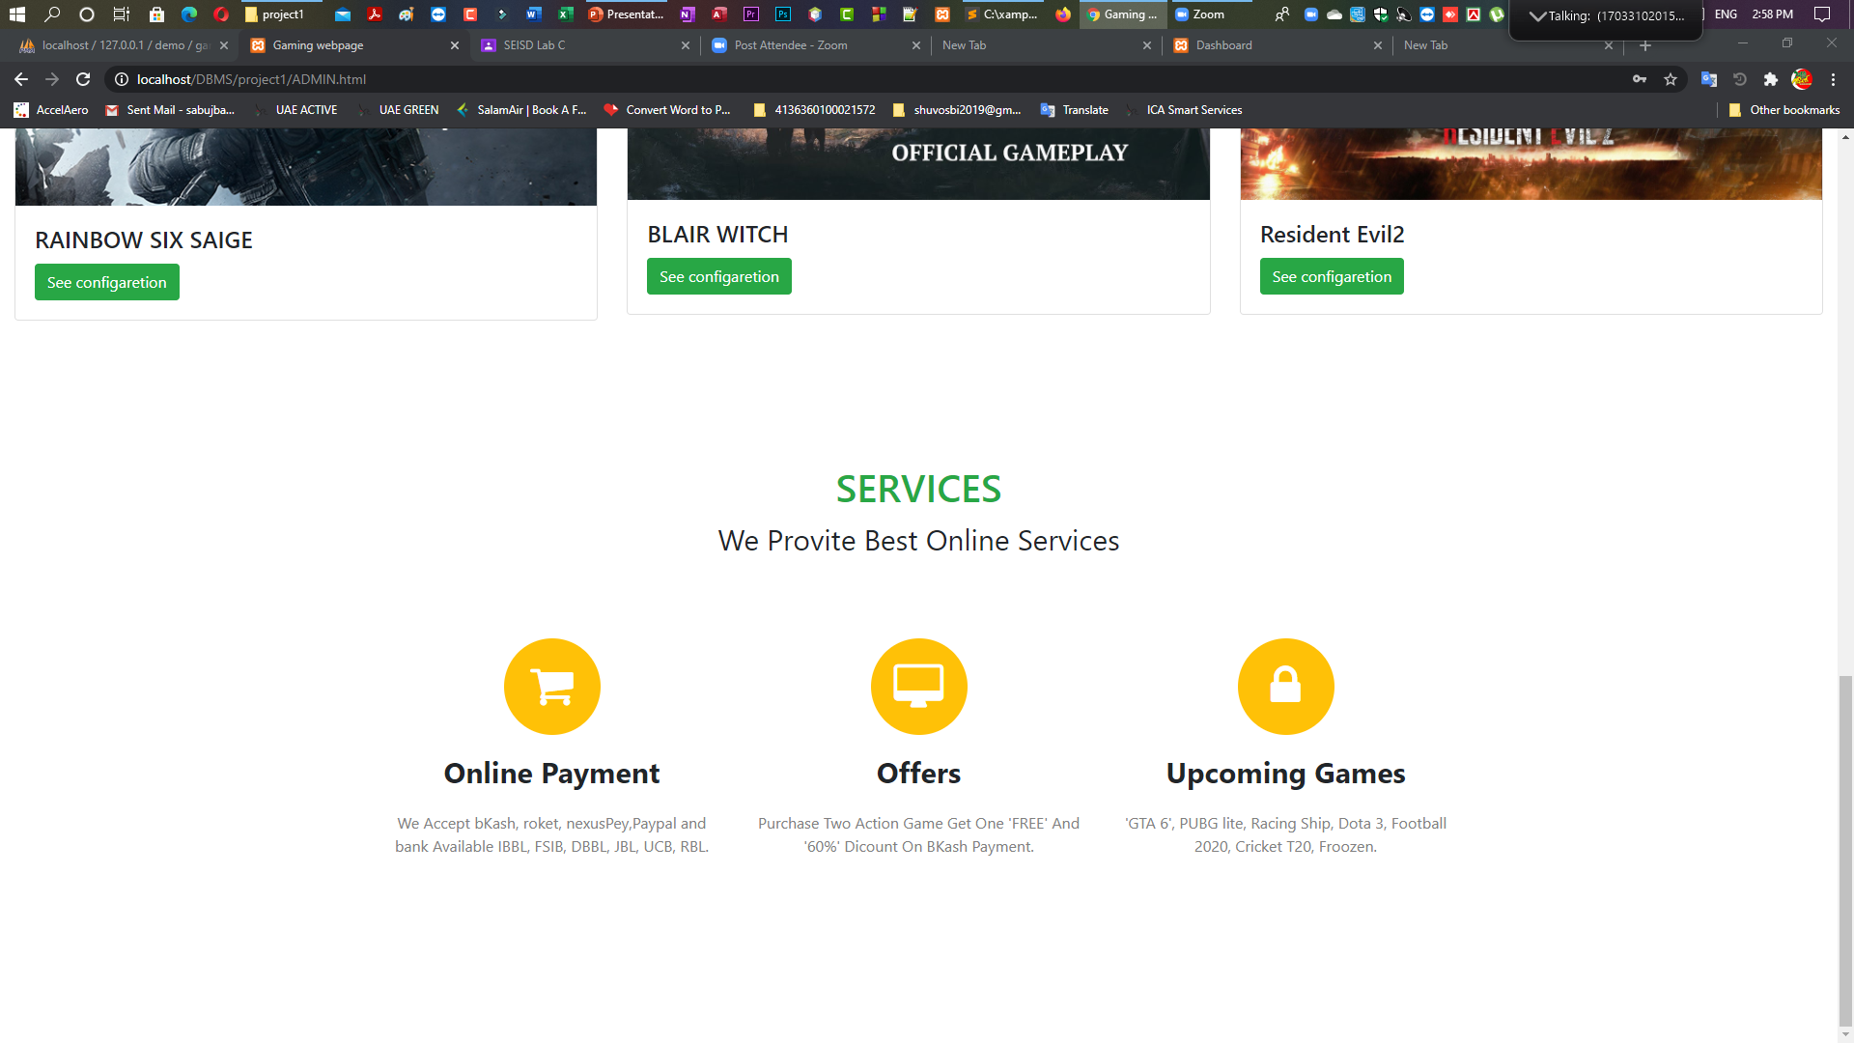
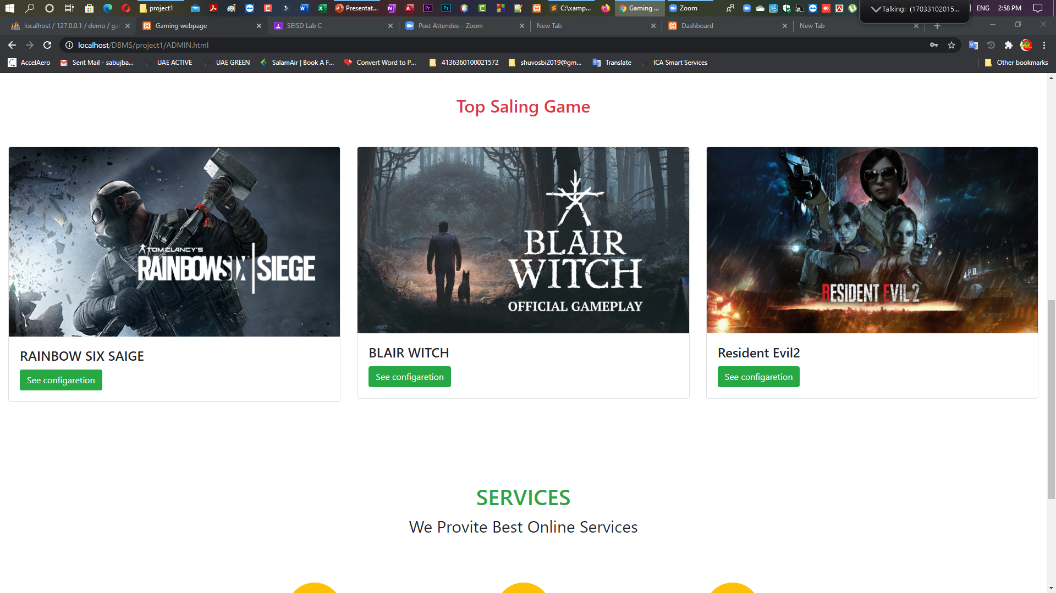

Slide 12
Conclusion
That all, this is from my site. I will
work on this project and implement
All my ideas.

Slide 13
Reference
www.google.com
https://getbootstrap.com
https://w3schools.com
www.youtube.com
www.GitHub.com

